Slide 1
POLS0008
INTRODUCTION TO QUANTITATIVE RESEARCH METHODS
WEEK FOUR: Sourcing DATA
Dr Andreas Mastrosavvas (a.mastrosavvas@ucl.ac.uk)
1

Slide 2
QUICK RECAP OF WEEK 3
2

Slide 3
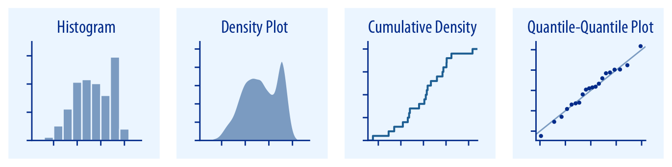
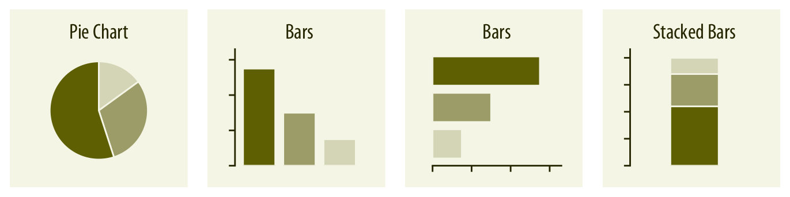
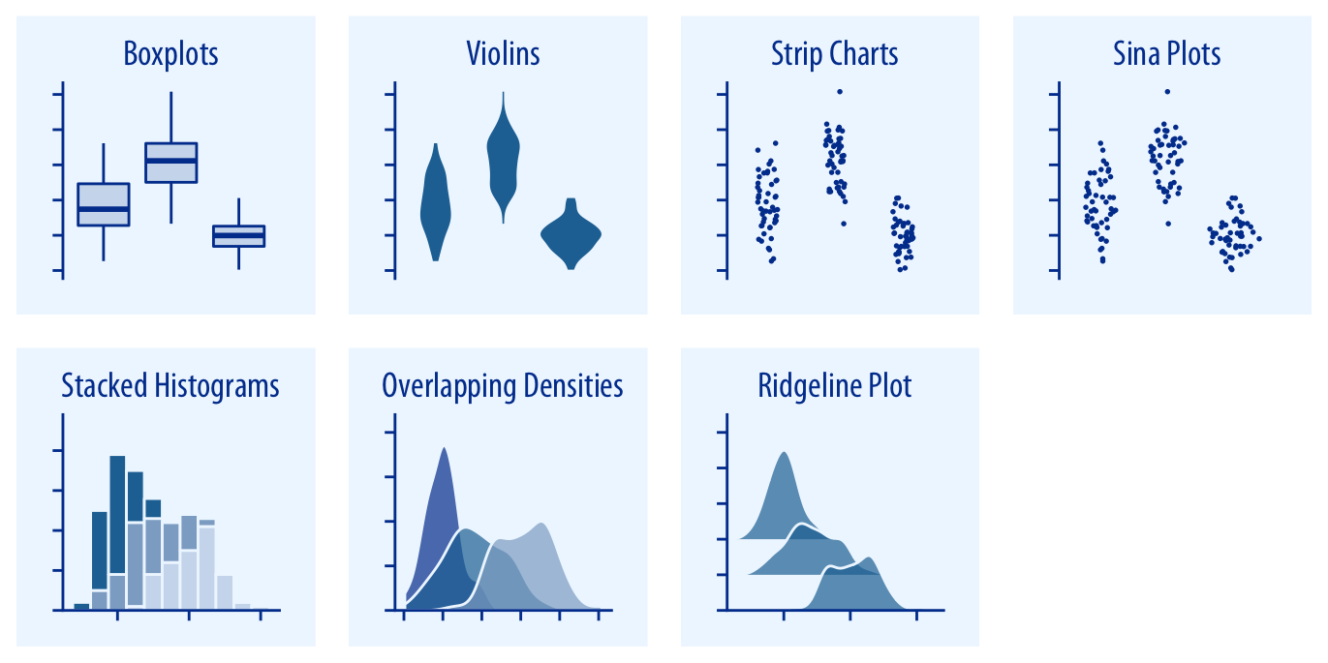
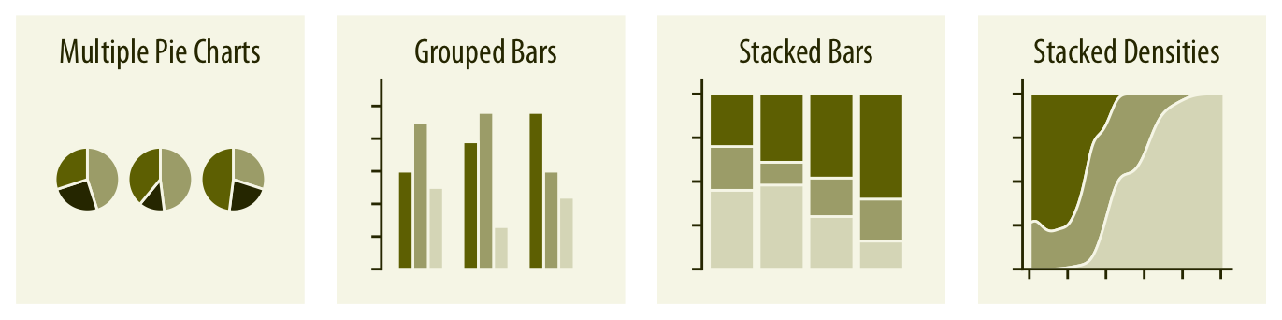
We covered some general techniques for data visualisation
Visualisations representing densities & distributions of numerical data
1. Plots for densities and distributions (numerical data)
2. Plots for proportions (qualitative or categorical data)
Single variable
Multiple variables
Source: Fundamentals of Data Visualization [LINK]
3

Slide 4
We covered the best practices for data visualisation
Everything on your graph should be labelled accordingly:
Title – a clear short title letting the reader know what they are looking at should be present. Or alternatively, a figure legend for that image will do.
Axis labels/titles – clear labels for the x and y axes must be present
Should include in the labelling the units of measurements [height (m), soil arsenic (mg/kg) etc.]
These labels should be short and descriptive
Legends – for categories in categorical variables which keys/colour codes must be present and labelled accordingly
Male and Female, and not 0 and 1.
Captions – If the graphics are NOT yours (i.e., its ripped from a source). Take the opportunity to apply a caption on the graph (on or beneath it) providing source attribution for the data.
Colour scheme – Use of colour scheme matters
Sequential colours – for plotting quantitative variable that goes from low to high (vice versa)
Diverging – for contrasting the extremes (low, medium and high) of a quantitative variable
Qualitative – e.g., nominal categories. Use to distinguish between different categories in a categorical variable
4

Slide 5
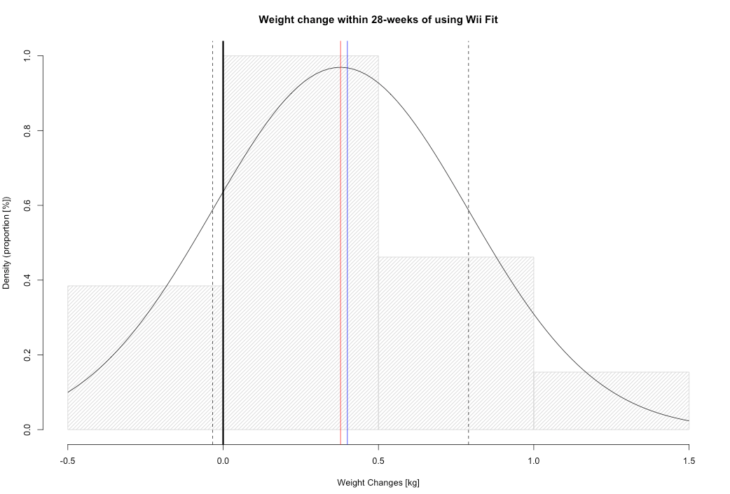
We covered an example using Base-R code
# R Code:
# enter data
weightChanges <- c(-0.2,-0.4, 0, 0.1, 0.1, 0.3, 0.12, 0.4, 0.5, 0.8, 0.9, 0.5, 0.6, 0.7, 0.6, 1.3, -0.2, 0, 0.1, 0.1, 0.3, 0.4, 0.5, 0.5, 0.6, 1.2)
# next, extract mean and standard deviation from data
m<-mean(weightChanges)
std<-sd(weightChanges)
# plot histogram with normal curve
hist(weightChanges, density = 20, prob=TRUE, main="Weight change within 28-weeks of using Wii Fit", xlab = "Weight Changes [kg]", ylab = "Density (proportion [%])")
# adds the normal curve
curve(dnorm(x, mean=m, sd=std), add=TRUE)
# add red line for mean
abline(v = 0.378, col = "red")
# add blue line for median
abline(v = 0.400, col = "blue")
# add black dashed line for -sd
abline(v = -0.034, lty = "dashed", col = "black")
# add black dashed line for +sd
abline(v = 0.79, lty = "dashed", col = "black")
# add blue line for median
abline(v = 0, col = "black", lwd = 3)
# Calculate probability
pnorm(0, mean=m, sd=std)
Note: Area beneath the curve before weight change value at 0 kg (black solid line),
tells me the predicted probability that the Wii Fit can reduce my weight.
Prob(Weight change < 0.0kg) = 0.1794 (17%)
5

Slide 6
We demonstrated further ways of visualising data in RStudio with ggplot( )
Creating impressive visualisation
Base functions for creating graphics in R: plot( )
R Packages for creating impressive plots: ggplot2( )
You will have to first install ‘ggplot2’ package first with the install.package( ) function
After its installed, you will need to load the package into R with library( ) function
All this will be become clear in the practical session
6

Slide 7
Data Sourcing
7

Slide 8
Contents
What’s data sourcing?
The distinction of primary and secondary data sources
Examples of sourcing data
Summarising the merits and limitations of using primary or secondary data
Brief notes on study design and sampling strategy
Description of data
Problem
Knowledge
Collect
Model
Wrangle
Explore
8

Slide 9
Format of today’s lesson goes…
Theory & Application
Student Feedback: 5-10 minutes
Break: 15 minutes
Description of Data
Summary of weeks 1-4
9

Slide 10
Lecture
10
Notes:
Alright now… let’s begin lectures now!

Slide 11
What is Data Sourcing?
Data sourcing (or data collection) is referred to how one goes out to gather data – this can be done either ‘ACTIVELY’ or ‘PASSIVELY’
ACTIVE: these are ways of acquiring records (or data) actively through fieldwork, surveys, interviews etc.,
PASSIVE: these are ways of acquiring records (or data) that are made available from some “official” (or “recognised”) sources (e.g., NGOs, agencies, companies, government, educational or research institutions etc.,)
Official (or recognised) sources can make their data freely available to everyone to use & republish, repurpose it as they wish without any patent, legal or copyright restrictions, or through a secured digital channel (e.g., Data Safehaven)
On the fourth point, we often refer to this term as “Open Data” [LINK] for datasets that are freely available. While, the term “Safe-Guarded Data” is used for those acquired through secured channels.
Open & Safe-Guarded Data are passive & falls under the broad type of data classification called “Secondary Data”, whereas the second point on active data collection is called “Primary Data”
11

Slide 12
Types of data sources
Primary data
This type of data source refers to the firsthand data gathered by the user, researcher or enumerator through fieldwork, interviews, questionnaire surveys etc.,
Secondary data
This type of data source typically refers to the data that has already been collected through a primary source and made readily available for other researcher(s) to use for their study or investigation
Internal
External
12

Slide 13
Secondary data
This type of data source typically refers to the data that has already been collected through a primary source and made readily available for other researcher(s) to use for their study or investigation
Internal Secondary data
If you are working within an organisation that has some relevant data of interest
The organisation has collected the data and can provide access to such users working within it or collaborators
Data scientists working within the UK Metropolitan Police Service seeking to quantify the burden of various crime outcomes: Burglary, sexual assault, vandalism, arson and so…
Data is collated by MPS and not by the data scientists
So MPS can release the data to such users, this is an example of Internal Secondary Data
13

Slide 14
Secondary data
This type of data source typically refers to the data that has already been collected through a primary source and made readily available for other researcher(s) to use for their study or investigation
External Secondary data
This simply refers to acquiring open datasets from external sources
Open-source websites (freely accessible)
Paying for the data (requires a license)
Online data service which is free but requires users to register etc.,
Release for FOI (Freedom of Information)
Sometimes you can combine both internal and multiple external data sources to supplement each other!
The umbrella term ‘secondary data’ can also be referred to as “routinely collected data”
14

Slide 15
Examples of Sourcing Data
15

Slide 16
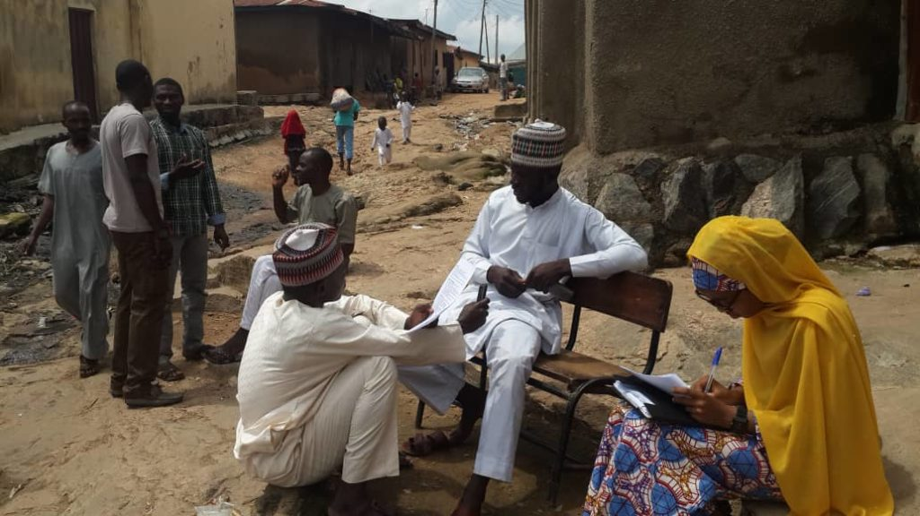
Example of primary data: Development Frontiers in Crime, Livelihoods and Urban
Poverty in Nigeria (FCLP) [1]
Themes:
Criminology
Social Science
Qualitative Research
Quantitative Research
Global South
Conventional analyses of crime, based on European research models, are often poorly suited to assessing the specific dimensions of criminality in Africa. Development Frontiers in Crime, Livelihoods and Urban Poverty in Nigeria (FCLP) aims to provide an alternative framework for understanding the specific drivers of criminality in a West African urban context.
Employing a mixed-methods approach combining statistical modelling, geo-visualisation and ethnography, the project situates insecurity and crime against a broader backdrop of rapid urban growth, seasonal migration, youth unemployment and informality. The study provides researchers both in Nigeria and internationally with a richer and more nuanced evidence base on the particular dynamics of crime in African cities.
16

Slide 17
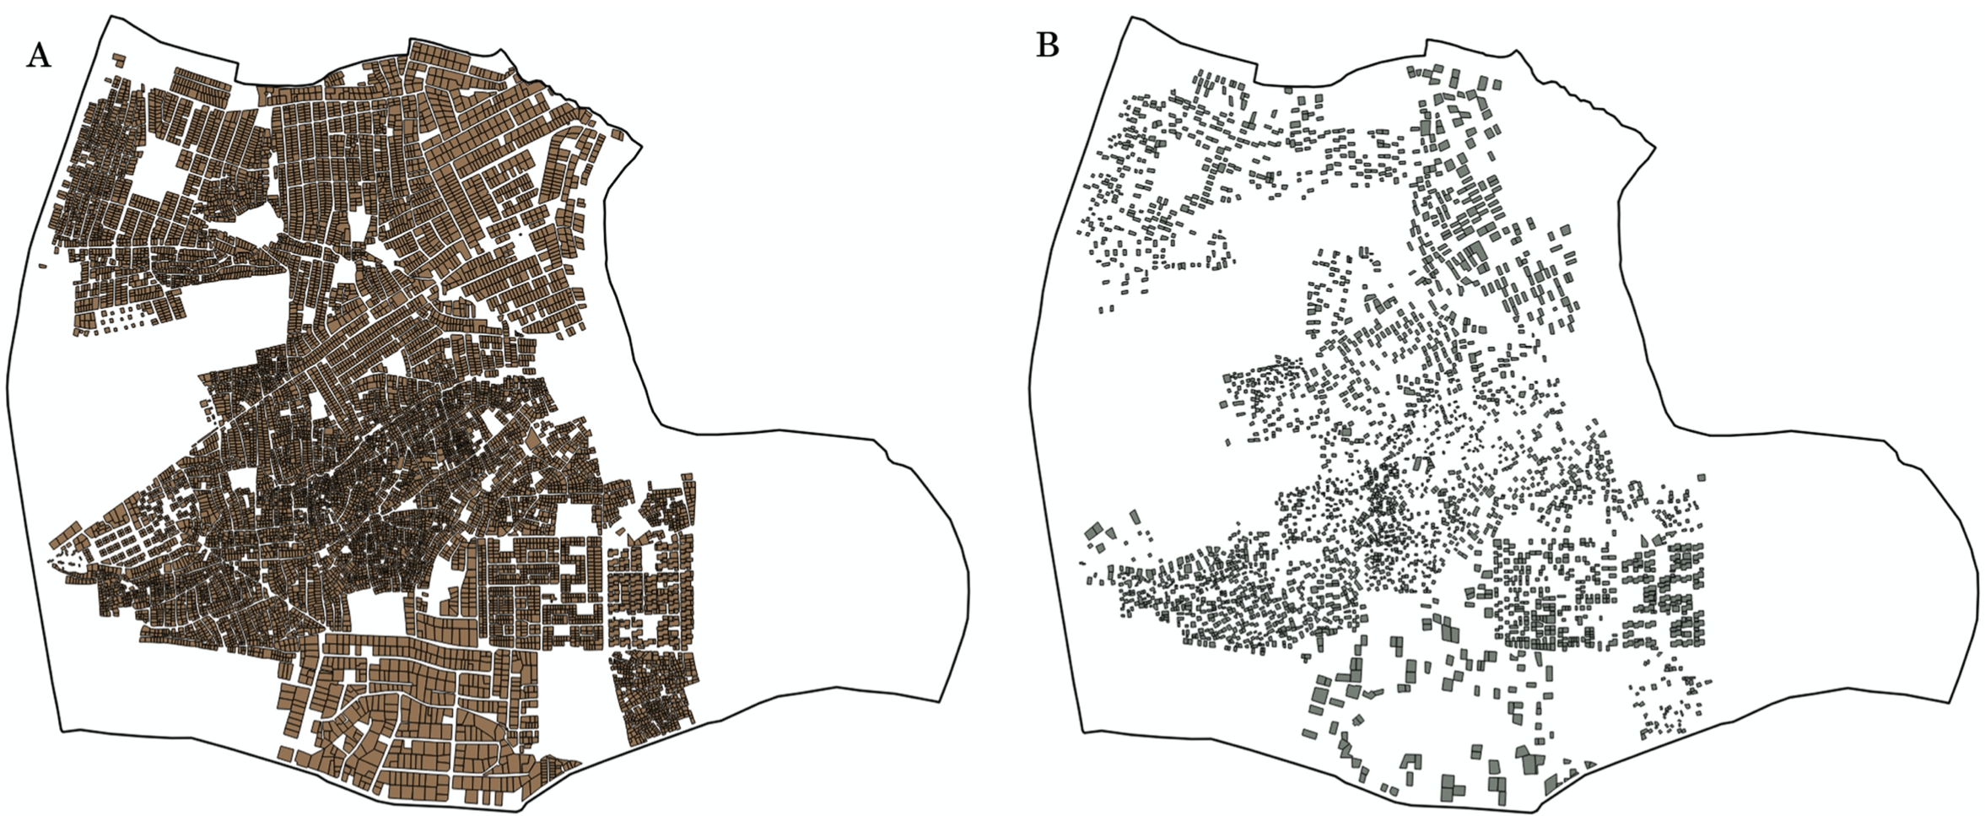
Example of primary data: Development Frontiers in Crime, Livelihoods and Urban
Poverty in Nigeria (FCLP)
See source(s):
Musah et al, 2020
Umar et al, 2020
Umar et al, 2017
Data collected:
Block Inventory Survey for the collection of environmental data
Household victimisation survey on indicators for crime
Perception of risk and neighbourhood safety
Demographic survey
Primary data and sampling strategy: 13,000 households, and the target sample was 2,300 for the victimisation survey (in Nigeria); we therefore used Systematic sampling to select at random 2,300 households [the applied criteria: k = 13,000/2,300 = 5.6 ~ 6th property (starting from the left-side of road)]
Houses mapped in B, we had to interview all those residents (i.e., 2,300 households) to collect a range of information.
17

Slide 18
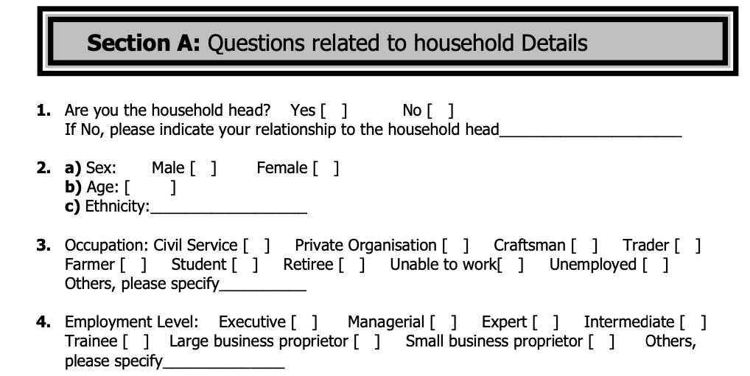
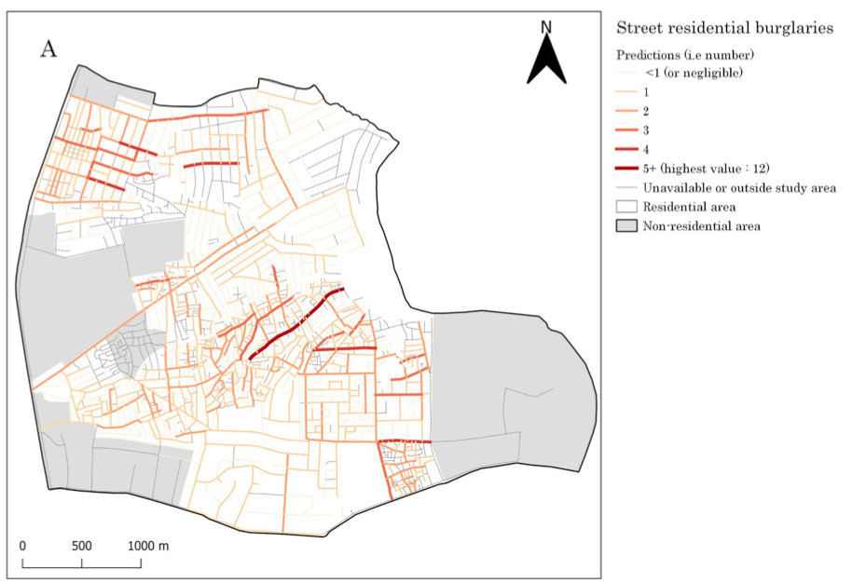
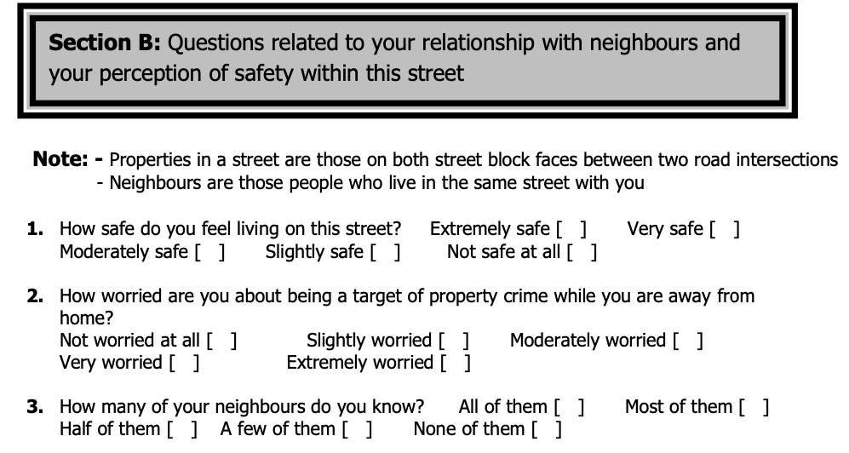
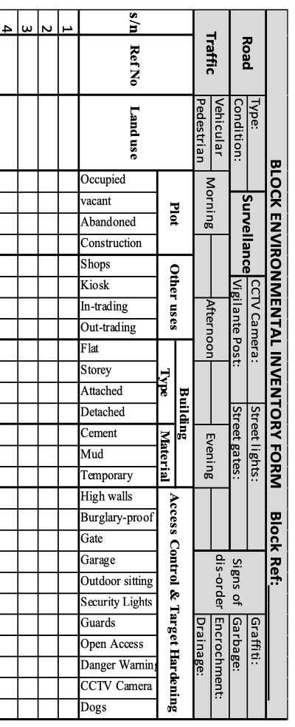
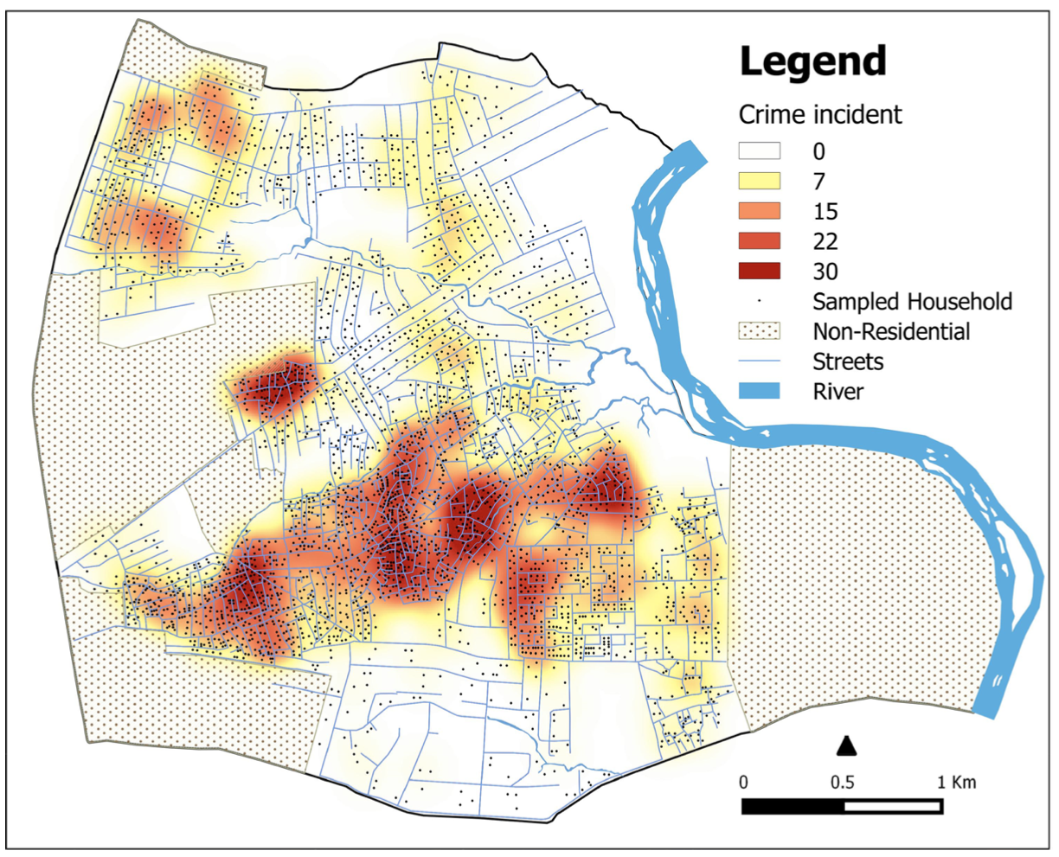
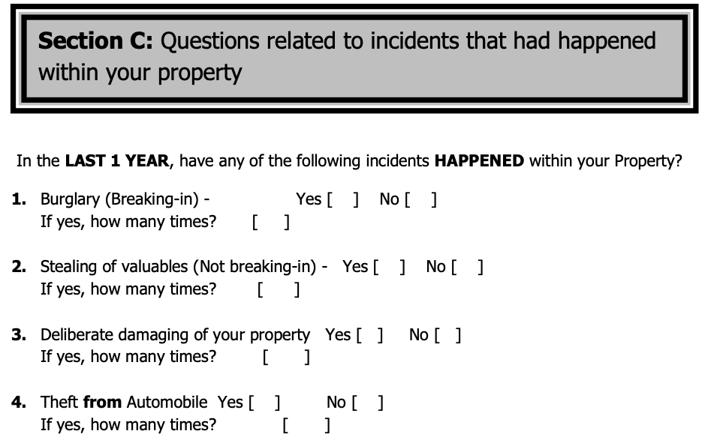


Sociodemographic variables
Physical characteristics variables
$$+$$
Perception and safety variables
Research 1: From the 2,300 household sample, we used the “crime pattern theory” to assess the risk of burglaries & victimisation at a street-level (see source: [LINK])
$$+$$
$$+$$
Victimisation (dependent) variables
Research 2: From the 2,300 households were sampled, we used the “laws of crime concentration” to assess the concentration of reported victimisation in this city (see source: [LINK])
18

Slide 19
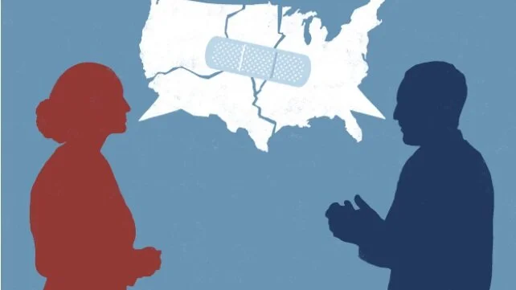
Example of secondary data: The geography of partisan homophily in the United States
Themes:
Social Science
Geography
Quantitative Research
Politics
Social Media
Image source
Political homophily in the United States is often proxied by residential proximity. The assumption is that if most people in a given neighbourhood vote Republican (or Democrat) then most of these people’s friends will also vote Republican (or Democrat). But as residential proximity is an imperfect proxy, we do not truly know the extent of political homophily across the US.
This study has created the first detailed country-wide map of political homophily in the United States based on actual data on the social ties among people. Combining Facebook data on aggregate social media friendships between US zip codes, and voting records from the 2020 US presidential election it shows which neighbourhoods in the United States are more likely to be socially connected to politically similar others.
19

Slide 20
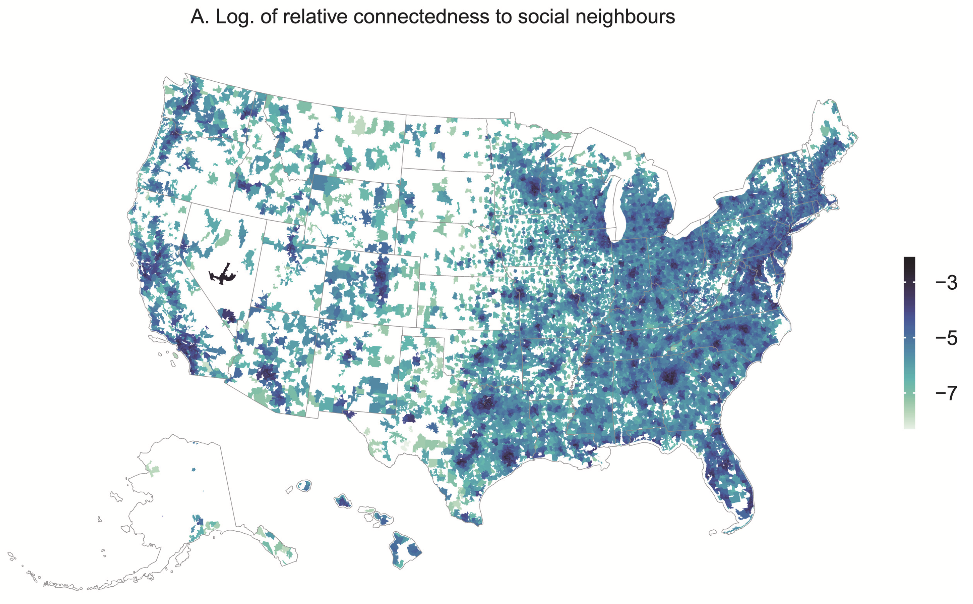
Example of secondary data: The geography of partisan homophily in the United States
Facebook data:
‘Social Connectedness Index’ produced by Meta
Meta Datasets
Measures density of Facebook friendships between zip codes
22,537 zip codes covered
Source:
Mastrosavvas, A. (2024)
20

Slide 21
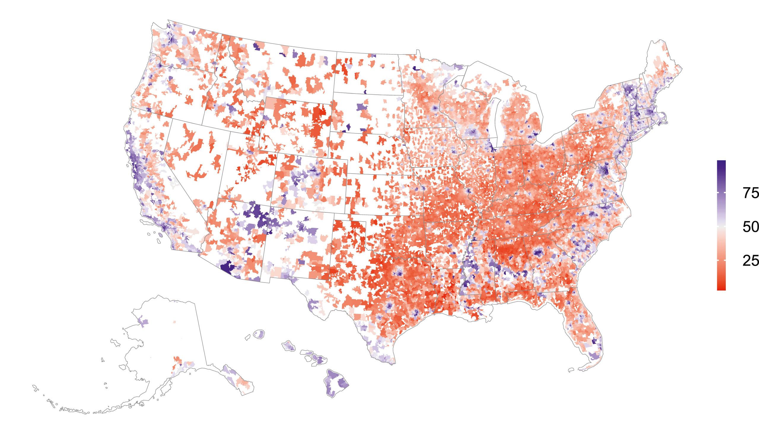
Example of secondary data: The geography of partisan homophily in the United States
Democratic two-party vote share in the 2020 US presidential election, by zip code
Voting records
Collected by local elections boards
Actual voting behaviour in the 2020 US presidential election
Source:
Mastrosavvas, A. (2024)
21

Slide 22
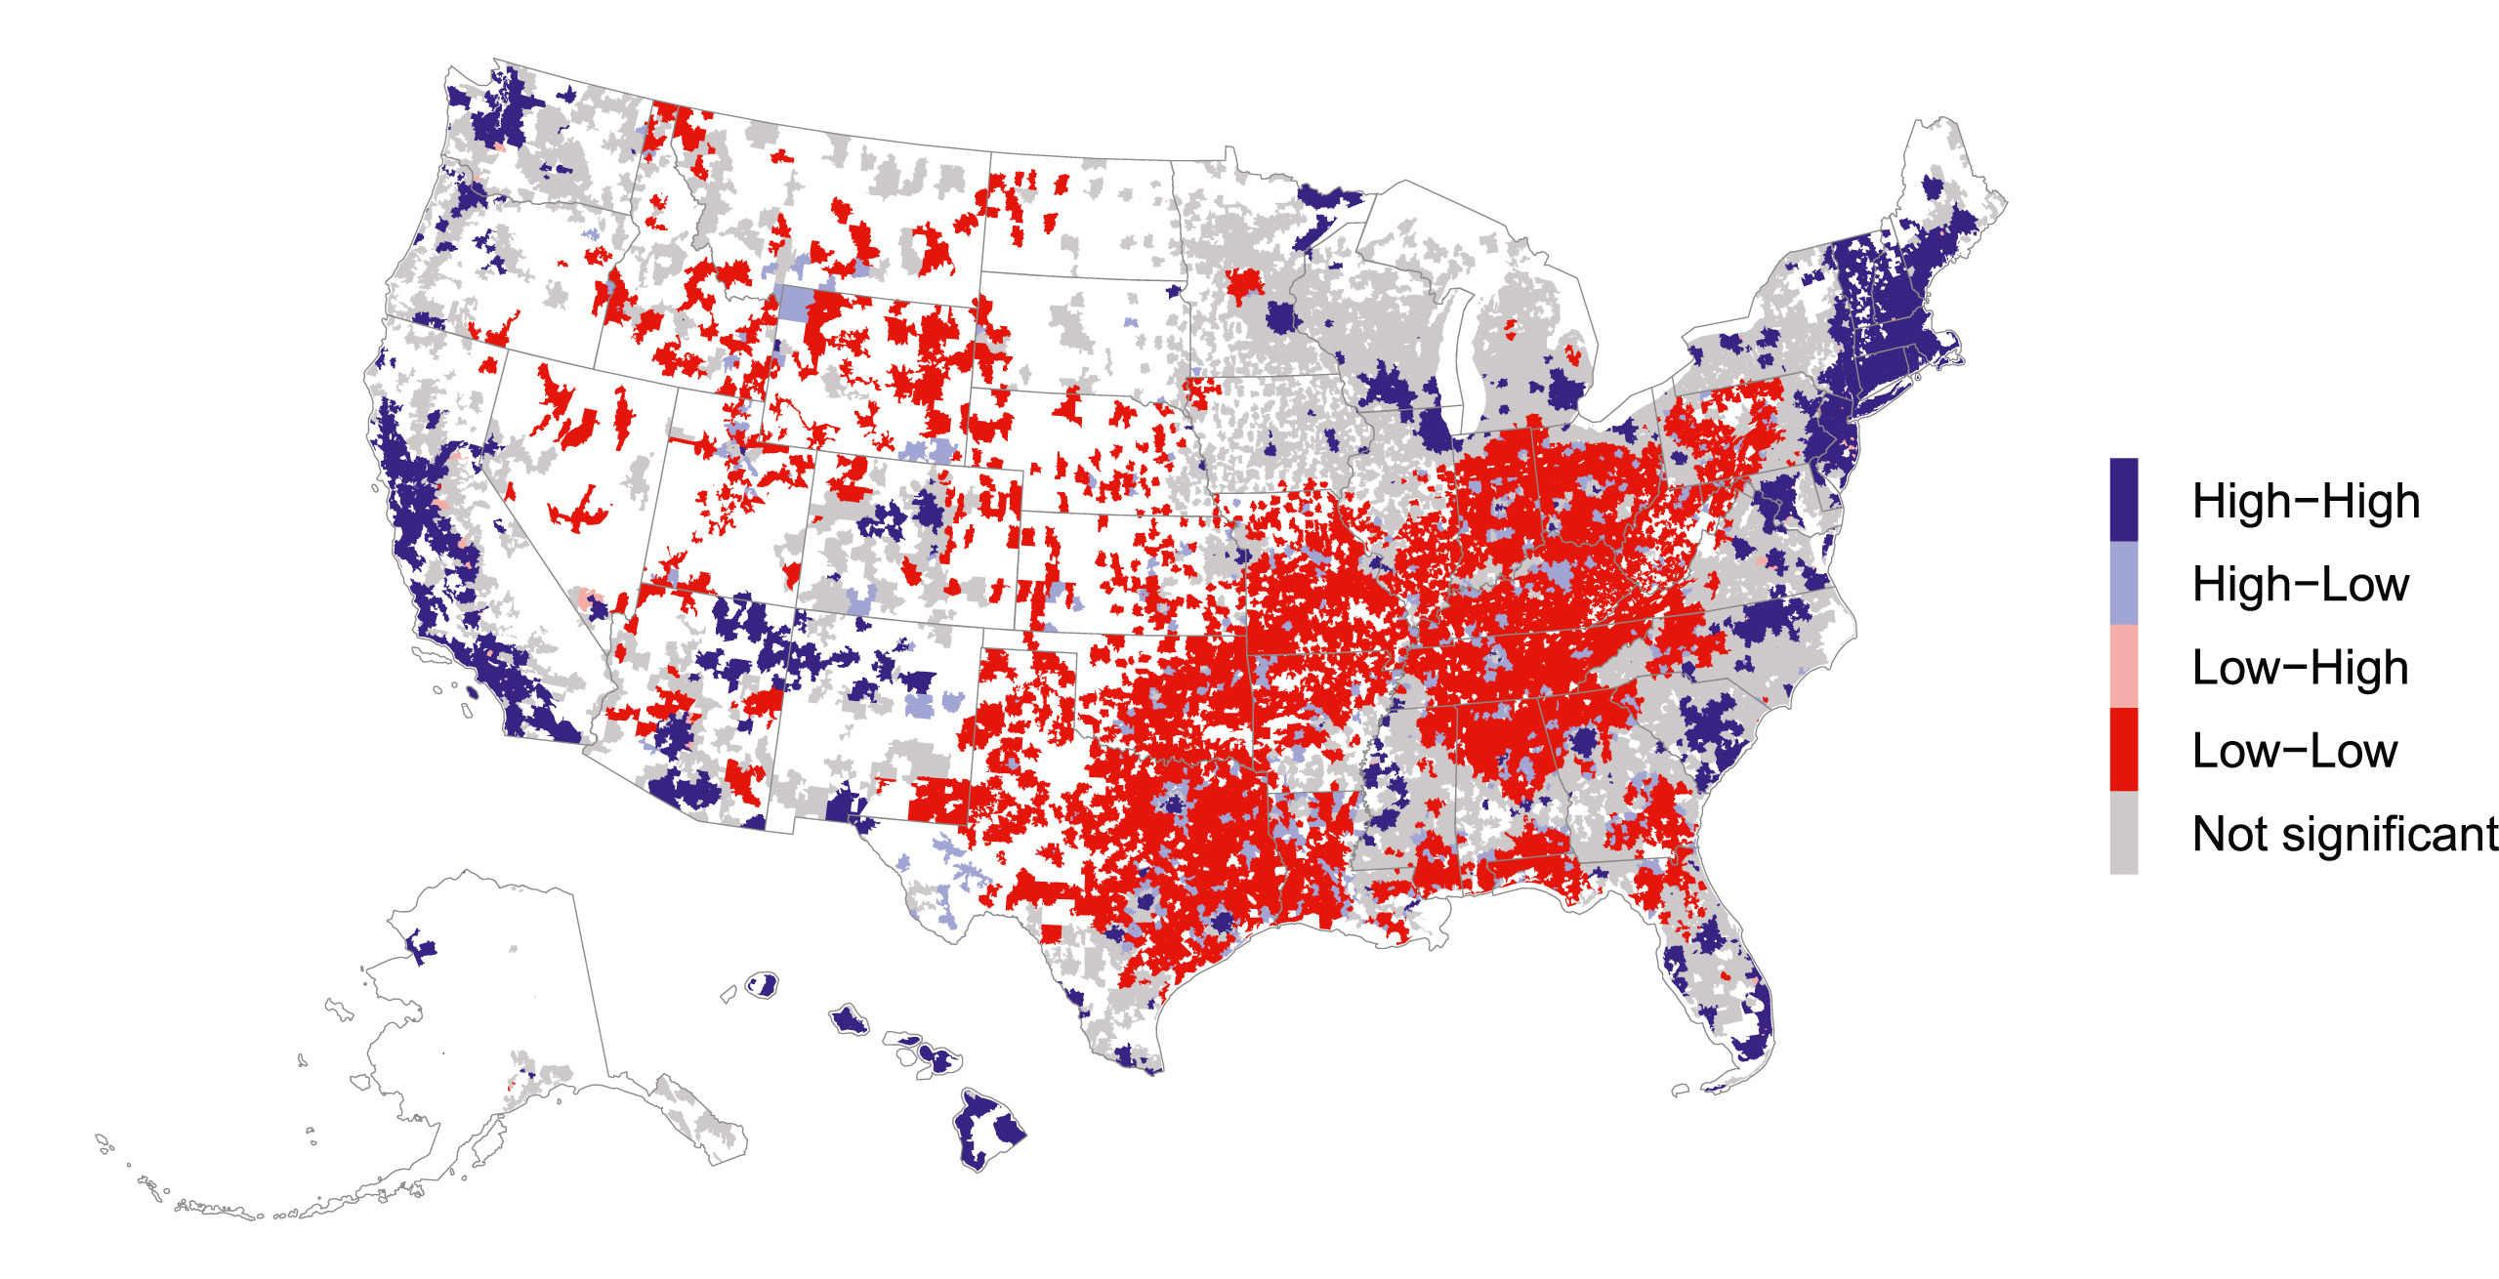
Example of secondary data: The geography of partisan homophily in the United States
Local Moran clusters, by zip-code
Source:
Mastrosavvas, A. (2024)
High-High: HIGH Democratic vote share in the area and HIGH in its socially conncected areas
High-Low: HIGH Democratic vote share in the area and LOW in its socially connected areas (etc)
22

Slide 23






Examples of open primary data for health research in Global South
23

Slide 24
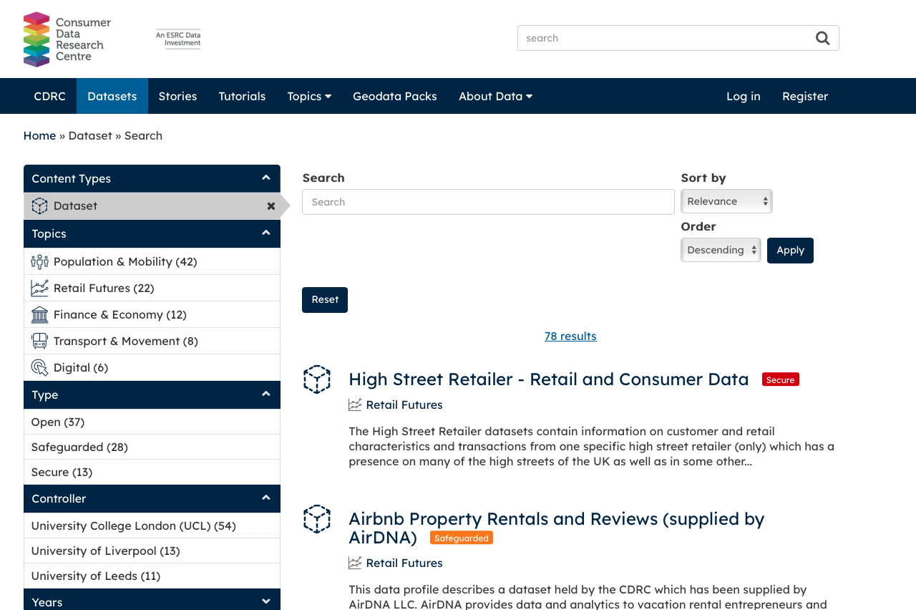
Example of secondary data: Consumer Data Research Centre (UCL)
CDRC provides data for research to address societal and economic challenges in the UK.
Contains tonne of open, safeguarded and secure data.
Website: https://data.cdrc.ac.uk/search/type/dataset
24

Slide 25
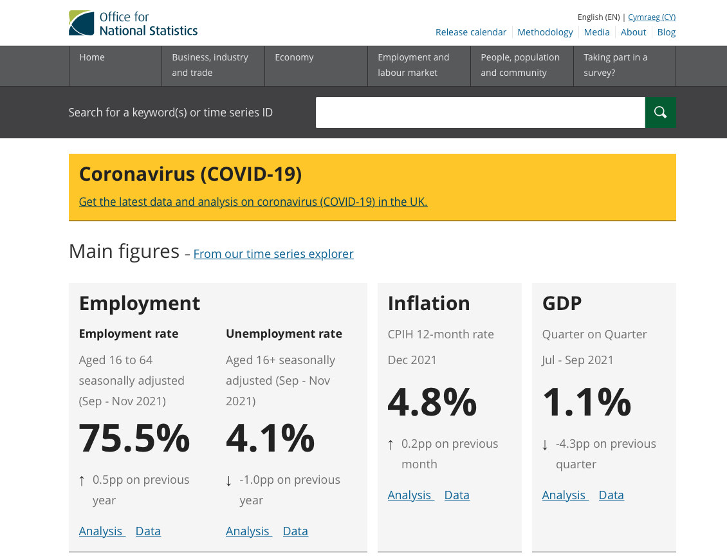
Example of secondary data: Office for National Statistics (ONS)
LINK: https://www.ons.gov.uk
ABOUT ONS:
It is responsible for the collation census data relating to the UK population, as well as the publication of statistics related to the UK economy, it’s population and wide range of societal matter as a whole.
UK government makes use of these statistics for their policy and decision making.
Actual raw UK data can be found from ONS and UK GOV.
25

Slide 26







Examples of open secondary data for social and political research in UK
[LINK]
IMD: [LINK]
[LINK]
[LINK]
26

Slide 27
Merits & Limitations
27

Slide 28
Advantages and disadvantages of Primary data sources
Advantages
Data collected is always up-to date
Relevant and specific to user’s research aims and objectives
High-level, and greater of understanding about the nature and content of the dataset
High-level of accuracy as long as you do whatever it is in your power to minimise all kinds of systematic errors in the data collection process (ensuring Internal Validity)
Disadvantages
Depending on the study design – data collection is a very time consuming and expensive process
If you are collecting personal and sensitive data, you must apply for ethnical approval before going out to get your data
You will have to clean, manage and maintain your own data
Possibility to falsify his/her data since one has his/her autonomy over the data
28
Notes:
Because you are the one who is collecting it

Slide 29
Advantages and disadvantages of Secondary data sources [2]
Advantages
Ease of access and low cost, or even free if the data is from an open-source platform.
Time-saving, especially if the data has already been processed and cleaned
Unlike primary data; secondary data are often collected routinely hence allowing for longitudinal analysis
Often secondary data are combined with different sources making it have a variety of variables.
Disadvantages
You have no control over the quality
The secondary data might not be specific to your needs
The data can be biased in favour of the one whose gathered it. User will not know of this data artefact!
You are not the owner and will never have full understanding of its nature & how it was collected (i.e., its essentially a “Blackbox”)
29
Notes:
Because you are the one who is collecting it

Slide 30
Brief notes on Study Design & Sampling
30
Notes:
I made references to study designs – so it is just fitting to briefly cover this.

Slide 31
Definition:
“Research Design typically refers to the investigator’s strategy or plan for tackling a research question through collection of data, analysis and interpretation of such data, and finally a thorough discussion of that said data.”
In other words, or simply put it in plain English:
“… it’s someone’s blueprint for answering a research question”
31
Notes:
When you are collecting data to answer a research question, it must be conducted within the context dictated by the research design you are using

Slide 32
Types of Research Design
Quantitative
This area allows the researcher to derive meaningful insight (or empirical evidence) about certain phenomena through analysis of numerical information
Descriptive studies
Observational Studies
Experimental Studies
Purpose: Evidence of causality (or an association); Internal validity and External validity
Qualitative
This area allows the investigator to gain meaningful insight (or empirical evidence) of certain phenomena through the study of non-numerical pieces of information
32
Notes:
… for the purpose of establishing these three things - Evidence of causality (or an association); Internal validity and External validity

Slide 33
Types of Study Design
Type | Study Design | Properties
Descriptive | Ecological (or geographic) Cross-sectional | Unit of observation are at group- or aggregated level (e.g., geographic unit) Data is collected on a single snap in time, and its useful for generating further hypothesis
Observational | Case-control Cohort (or longitudinal) | Observe the effect of an independent variable(s) on an outcome that has already occurred. The time frame is a retrospective analysis Observe the effect of an independent variable(s) on an outcome that has not happened yet. The time frame is a prospective analysis
Experimental | Randomised control trials (RCT)* | Observe the effect in an actual test group(s) (e.g., intervention, effectiveness of a teaching programme, clinical trials for a vaccine)
Pilot study is a special cases as it could be anyone of these study designs
33

Slide 34
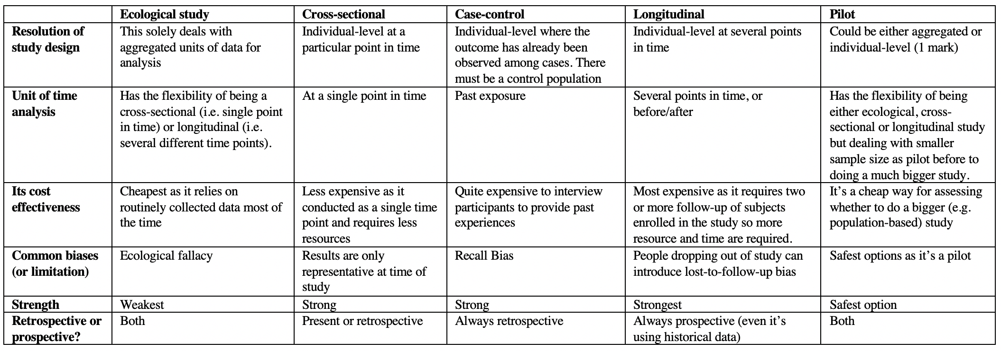
Comparison of quantitative-based study designs
34

Slide 35
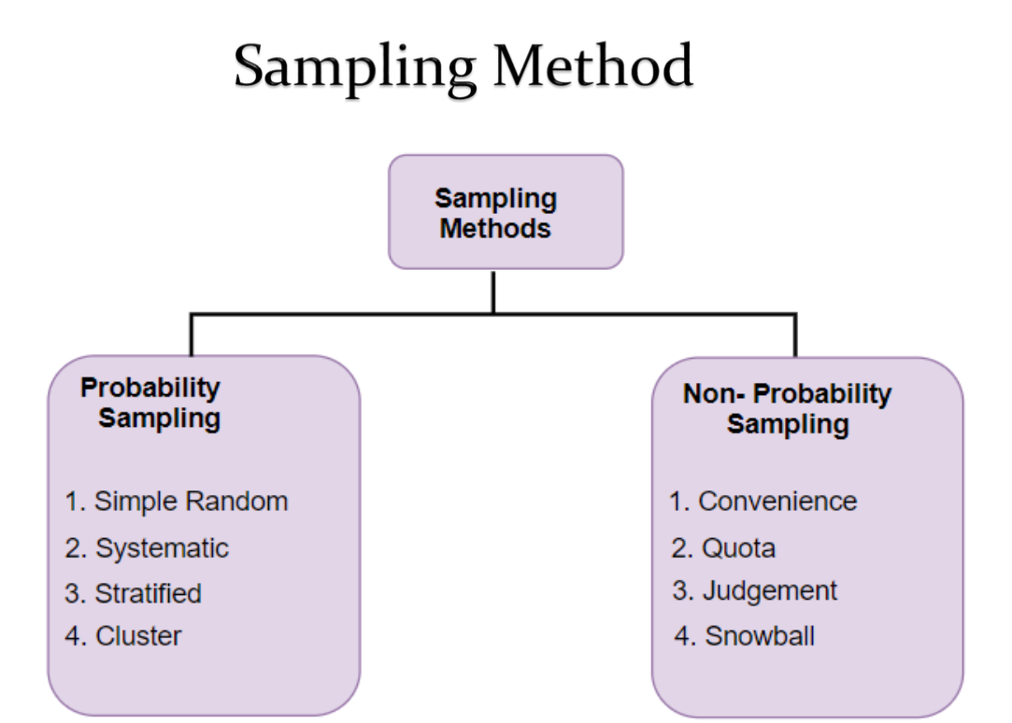
Sampling Strategy
Notes:
Simple Random Sample is a subset of population in which each member of the subset has an equal chance of being select at random.
Systematic Random sampling is another probability sampling approach where you have a list of individuals from a target population and perform a selection by starting somewhere at random and then collecting data at a fixed interval from that starting point.
Stratified Random Sampling is an approach that requires one to divide the population and group them by a common characteristic, and then start sampling individuals from each groups at random
Cluster Sampling is an approach that requires one to select a cluster unit(s) at random and then survey everyone in the selected cluster unit (usually smaller populations such a villages, or small schools in remote areas etc.,)
Warning: You cannot use any statistical method on samples that were collected with non-probabilistic approach – that element of randomness has been removed and thus render the sample not representative of the population. If you intend to use the quantitative route do not use a non-probability sampling approach.
35
Notes:
Just before we go on break

Slide 36
POLS0008: Course Evaluation & Student Feedback (2025/26)
https://forms.gle/uvGD3PWuMN4Cf2iu5
Dear Students,
As part of the Continuous Module Dialogue, we are conducting this survey to gauge the levels of student satisfaction with the learning experience in module POLS0008: Introduction to Quantitative Research Methods. We would like to receive your feedback regarding the sessions for week 1, 2, 3 (and 4). Your feedback is greatly appreciated. This will help us make improvements to the course. The survey should only take up to 5 or 10 minutes, and your responses are completely anonymous.
Thank you,
Andreas and Stephen
36

Slide 37
Break

Slide 38
Description of data
38
Notes:
This part is the first question of the assignment, the answer you provide here is quite an involved process.

Slide 39
Description of Data [1]
BEFORE YOU START THE ANALYSIS - you are required to provide some information about the dataset you are using regardless if its primary/secondary
Describing the where, what and when:
What: Here, you are mentioning the name of the data source and its use for a bigger study
When: The year(s) (or date(s)) at which it was collated
Where: The location of focus for which the data was collated from
Specific details about how the data was collated:
Whether its through questionnaire survey, interview etc.,
Research framework i.e., ecological, pilot, cross-sectional, or longitudinal etc.,
Sampling strategy
Who and what the target population was i.e., target sample size and group of focus (e.g., Adults only i.e., 18 years and above etc.,)
39

Slide 40
Description of Data [2]
[continue]
Describe the variables that’s going to be used for the analysis:
Codebook (see next slide) – provide a list of all the intended variables that is going to be analysed. You must mention specific details about variable – information such as the name, variable type (i.e., numeric or categorical) etc.,
Initial sample characteristic table – this is a breakdown on the number of observation documented for each variable (- i.e., what’s present and missing).
Example 1, suppose the total is 100 and 89 respondents provided the ages. In this table, the mean age is calculated from that 89. You must report that the mean is based on 89 point, and 11 points are missing data.
Example 2, suppose the total is 100, where 51 were women and 42 were men. You must report the numbers and percentage for each category and report the numbers (& proportion) of missing data in the gender variable. This means including a third category: men (42), women (51), and unknown/missing (7)
40

Slide 41

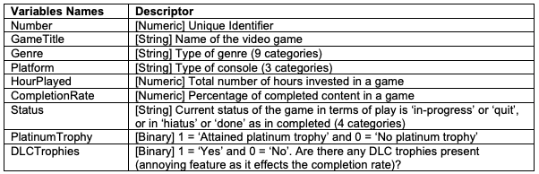
A Video gamer’s statistics
We have compiled the following information about the gaming habits of Anwar Musah (aka The-PhD-Gamer) across 3 console generations i.e., PlayStation 3, 4 and 5.
There are 161 game titles (~6,000 hours of game time) listed in the shared dataset (last updated 01/2024).
PSNProfiles (https://psnprofiles.com/)
This table is an example of codebook!
Data Descriptor: [Downloadable Dataset]
We are going to use this data as a test dummy. We are just going to access RStudio server and then show how to import this dataset.
Then set you folks going for the practical material to prepare for the seminars on Thursday.
41

Slide 42
ID | Name | Age | Gender | Pathway | Gamer
0001 | Brittany | 18 | Female | NA | No
0002 | Idris | NA | Male | NA | NA
0003 | Spike | 19 | Male | Political | Yes
0004 | Lara | 20 | Female | Geography | Yes
0005 | Nana-Kwesi | 17 | Male | Health | No
0006 | Xiaoyu | 23 | Female | Geography | NA
Raw dataset
Characteristic | Breakdown on what’s present in the dataset
Age (in years) | Mean 19.7 (n = 5, 1 missing)
Gender
Women | 4 (66%)
Men | 2 (33%)
Missing/Unknown | 0 (0%)
Pathway
Political | 1 (16.5%)
Health | 1 (16.5%)
Geography | 2 (33%)
Missing/Unknown | 2 (33%)
Gamer Status
Yes | 2 (33%)
No | 2 (33%)
Missing/Unknown | 2 (33%)
Show what’s available
To show missing numbers by category
table(dataset$pathway, useNA = “always”)
To exclude the missing entries
mean(dataset$age, na.rm = TRUE)
summary(dataset$age, na.rm = TRUE)
42

Slide 43
Description of Data [3]
[continue]:
Here, we make an explicit statement about missing data bias and complete case before proceeding with the analysis
Complete case analysis: Here, you are making a declaration that you are sub-setting the dataset to cases who have complete information across ALL variables (no missing information), and that you are restricting the dataset & analysis to respondents without missing data.
ID | Name | Age | Gender | Pathway | Gamer
0001 | Brittany | 34 | Female | NA | No
0002 | Idris | NA | Male | NA | NA
0003 | Spike | 32 | Male | Political | Yes
0004 | Lara | 29 | Female | Geography | Yes
0005 | Fiona | 28 | Female | Health | No
0006 | Xiaoyu | 29 | Female | Geography | NA
Sample size = 6
43

Slide 44
Description of Data [4]
Code:
dataset_nomissing <- dataset[complete.cases(dataset), ]
[continue]:
Here, we make an explicit statement about missing data bias and complete case before proceeding with the analysis
Complete case analysis: Here, you are making a declaration that you are sub-setting the dataset to cases who have complete information across ALL variables (no missing information). You are restricting the dataset to respondents without missing data.
ID | Name | Age | Gender | Pathway | Gamer
0001 | Brittany | 34 | Female | NA | No
0002 | Idris | NA | Male | NA | NA
0003 | Spike | 32 | Male | Political | Yes
0004 | Lara | 29 | Female | Geography | Yes
0005 | Fiona | 28 | Female | Health | No
0006 | Xiaoyu | 29 | Female | Geography | NA
Sample size = 6
Delete 3 rows
44

Slide 45
Description of Data [5]
Code:
dataset_nomissing <- dataset[complete.cases(dataset), ]
[continue]:
Here, we make an explicit statement about missing data bias and complete case before proceeding with the analysis
Complete case analysis: Here, you are making a declaration that you are sub-setting the dataset to cases who have complete information across ALL variables (no missing information). You are restricting the dataset to respondents without missing data and use it for the analysis.
ID | Name | Age | Gender | Pathway | Gamer
0003 | Spike | 32 | Male | Political | Yes
0004 | Lara | 29 | Female | Geography | Yes
0005 | Fiona | 28 | Female | Health | No
Sample size = 6
Delete 3 rows
Retained sample = 3
Drop-out rate = 50%
Missing data bias: Here, you must acknowledge that due to the sample reducing from what was initially A to B, and restricting it to complete case sample, you have introduced some bias in your results.
45
Notes:
Low statistical power
Poor drop-out rate if the records deleted are excessively high. How high – it depends on the user.

Slide 46
From next week: inferential statistics
46

Slide 47
Thank you
47

